Slide 1
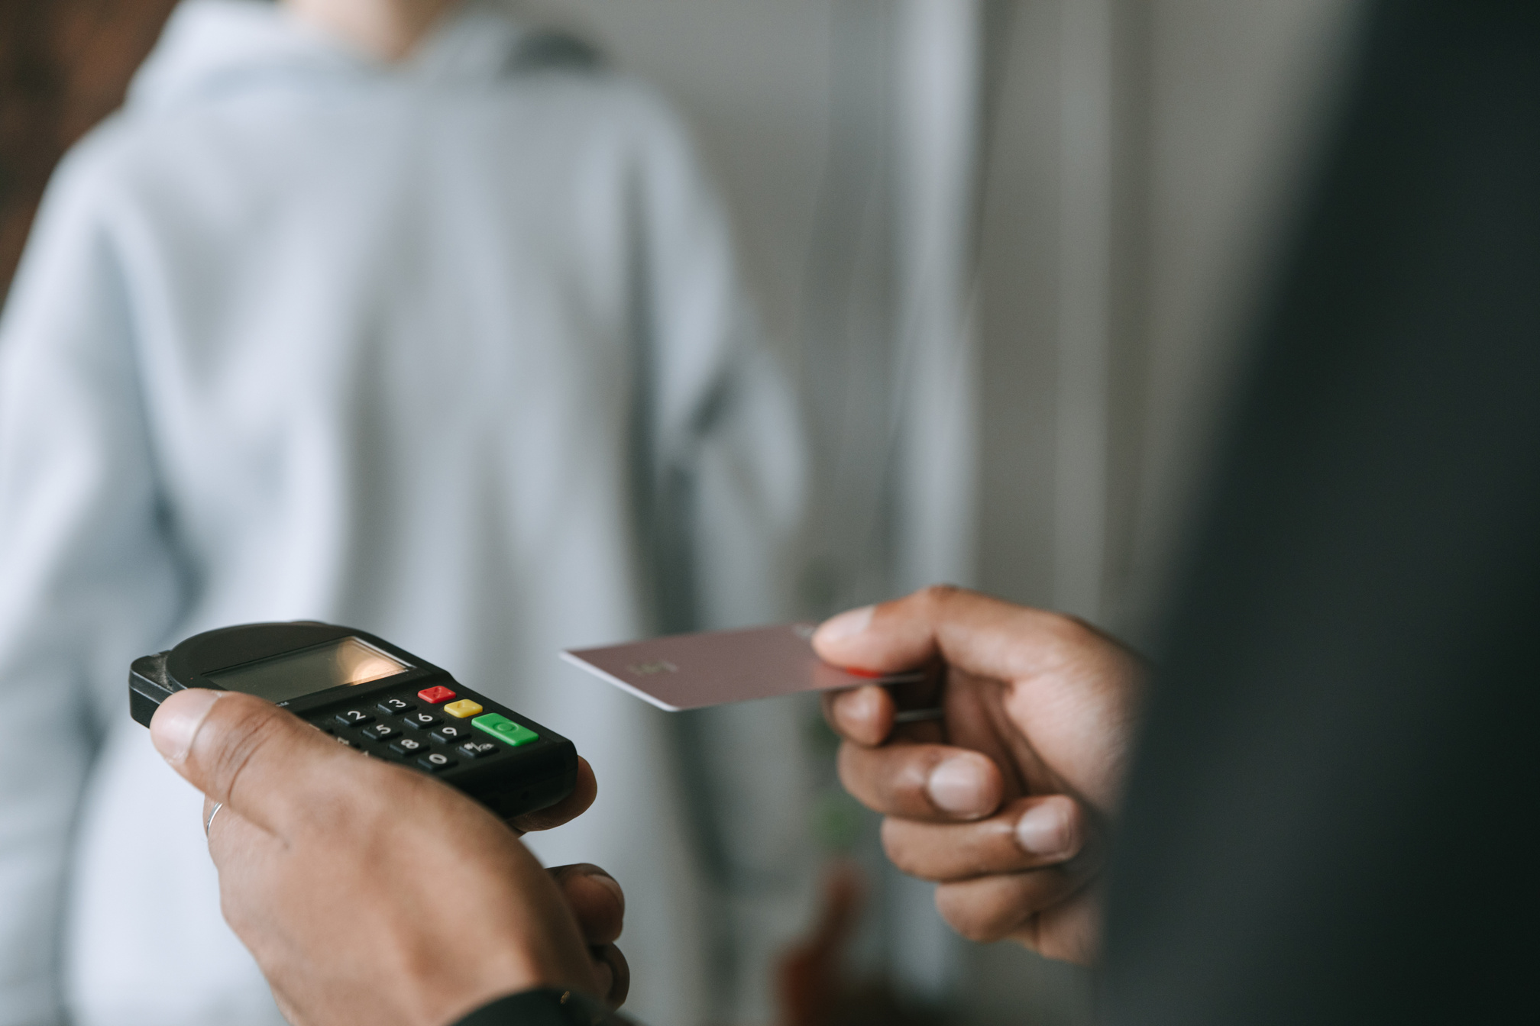


An overview of banking fraud transactions, detection, and Analysis.
Empowering Fraud Prevention
BankingFraudTransactions Analysis
Presented by
RITTIKA GHOSH
Student code :
AFO5173453

Slide 2

What is Banking fraud
Understanding the Basics
Bank fraud is the act of illegally obtaining money, assets, or sensitive financial information by deceiving a bank, its customers, or financial institutions. It involves unauthorized or fraudulent transactions carried out for financial gain.
ACTION
Protecting customer accounts
Detecting fraudulent transactions

Slide 3

Types of Banking Fraud
Credit
Debit
1. OFFLINE FRAUD (PHYSICAL/BRANCH-BASED FRAUD)
Cheque Fraud
Loan Fraud
Cash Theft
2. ONLINE FRAUD (DIGITAL/CYBER FRAUD)
Phishing
Smishing
Vishing
Net Banking Fraud
UPI Fraud
Duplicate website and application.

Slide 4


Project Objective
Pattern Recognition
Develop an interactive Power BI dashboard to monitor banking transactions, identify fraud patterns, and support decision-making.
OBJECTIVES
Analyze banking transaction data.
Monitor transaction behavior.
Detect suspicious login attempts.
Identify high-risk locations.
Analyze customer demographics.
Track transaction trends over time.
Provide management with real-time insights.
Analyze transaction amounts by customer occupation and age group.

Slide 5

Dataset Information
Dataset Overview
DATASET SUMMARY
Total Records: 50,000 Transactions
Time Period: 2020 – 2025
Transaction Types: Credit, Debit
Transaction Channels: ATM, Online, Branch (Offline)
Locations: Multiple cities
Customer Information: Account ID, Age, Occupation, Account Balance
Fraud Indicators: Transactions ID, Transaction Amount, Merchants ID, Login Attempts, Device ID, IP Address, Transaction Duration
Dataset: Bank Transactions Dataset for Fraud Detection
Source: Kaggle
URL: https://www.kaggle.com/datasets/thuandao/bank-transactions-dataset-for-fraud-detection

Slide 6
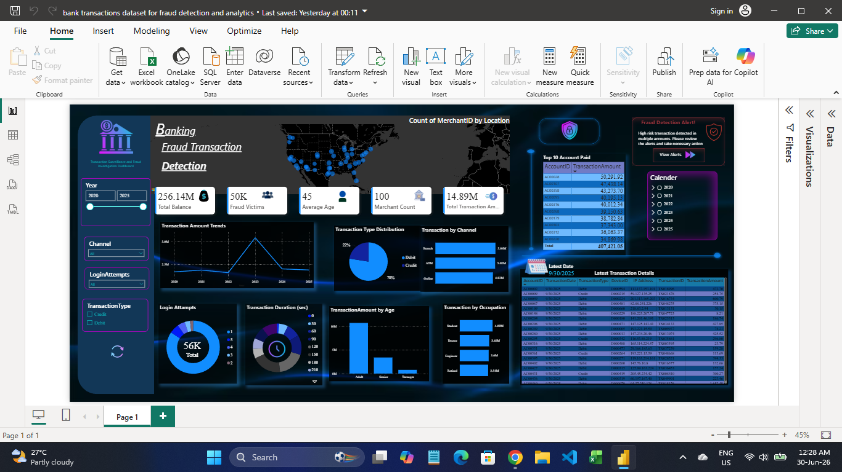
The dashboard provides visual analytics to identify suspicious activities efficiently.
Banks process thousands of transactions every day. Detecting fraudulent activities manually is difficult due to:
DASHBOARD
Large transaction volumes
Multiple transaction channels
Different customer behaviors
High financial risk
Need for quick fraud detection
Analytics Screen

Slide 7
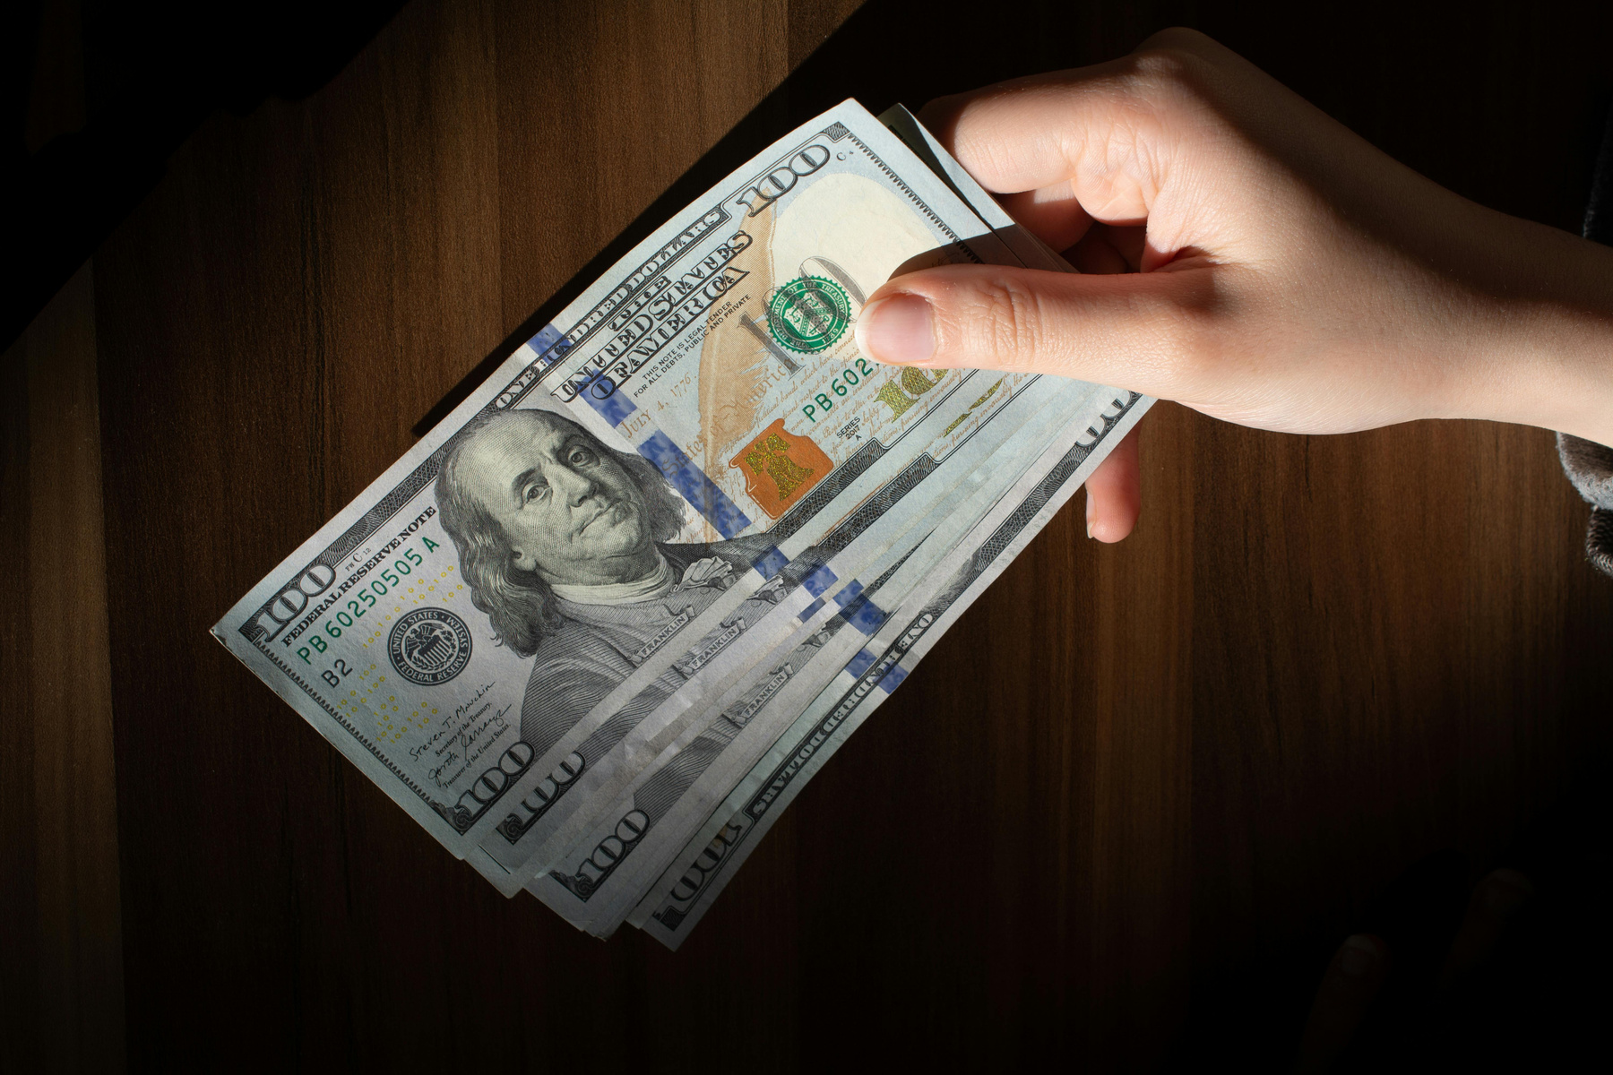
TOTAL BALANCE
FRAUD VICTIMS
AVERAGE
CUSTOMER AGE
MERCHANT COUNT
TOTAL TRANSACTION
AMOUNT
256.14 Million
50,000
45 Years
100
256.14 Million
Dashboard
KPIs
Total Balance: Measures the total balance across all customer accounts to monitor the bank's overall financial position and liquidity.
Fraud Victims: Shows the total customer accounts analyzed to support fraud monitoring and risk assessment.
Average Customer Age: Displays the average age of customers to understand demographic trends and customer behavior.
Merchant Count: Counts the number of unique merchants to analyze merchant activity and identify high-risk merchants.
Total Transaction Amount: Measures the total value of all transactions to track transaction volume and overall banking activity.

Slide 8
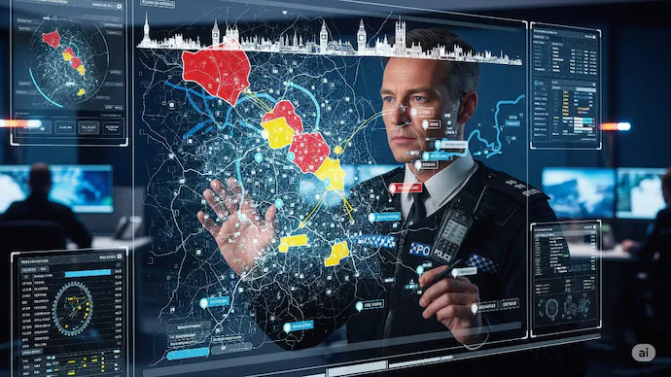
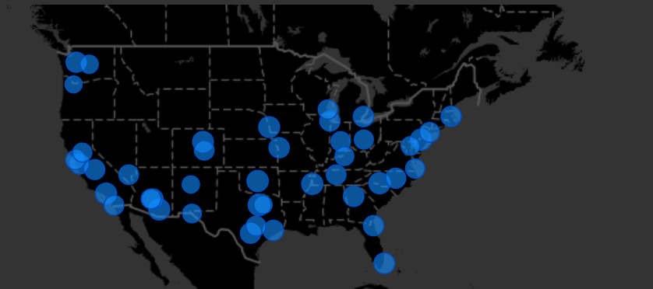


Geographic Analysis
Map Visualization
Visualize the geographic distribution of
merchants and banking transactions
to identify transaction hotspots and
potential fraud-prone areas.

Slide 9
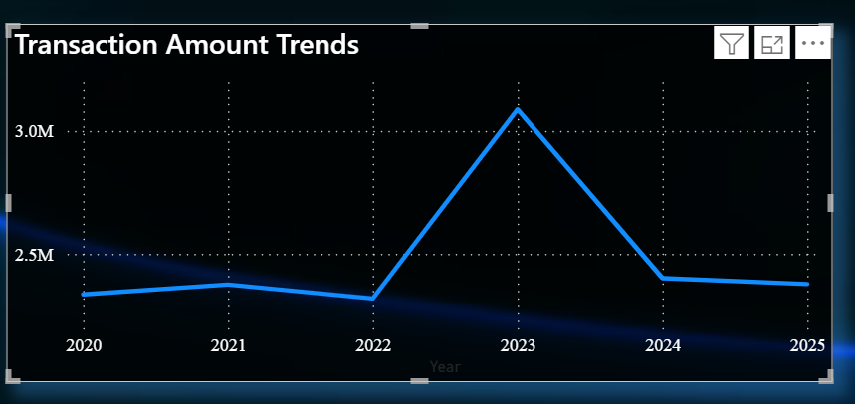
Displays how transaction amounts change over time (year-wise).
ANALYSIS
The chart shows transaction activity from 2020 to 2025.
The transaction amounts remained relatively almost same between 2020 to 2022.
A significant peak is visible around 2023, indicating higher transaction volume.
After 2023, transaction values remain relatively stable.
Line Chart
Transaction Amount Trend
ACTIONS
✔ Investigate the cause of the 2023 transaction spike.
✔ Apply additional authentication for large transactions.
✔ Continuously review yearly transaction trends and fraud patterns.

Slide 10
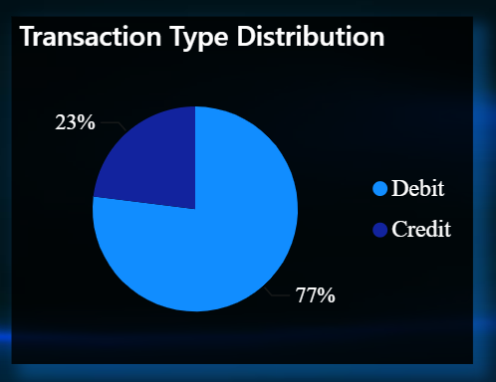
Compares Credit and Debit transactions.
ANALYSIS
Debit transactions: ~77%
Credit transactions: ~23%
Customers suffered fraud with debit transactions much more frequently than credit transactions.
Pie Chart
ACTIONS
✔ Enhance monitoring of debit transactions.
✔Set transaction limits and real-time alerts.
✔ Continuously monitor high-value credit transactions.
✔ Educate customers on secure banking practices.
Transaction Type Distribution

Slide 11
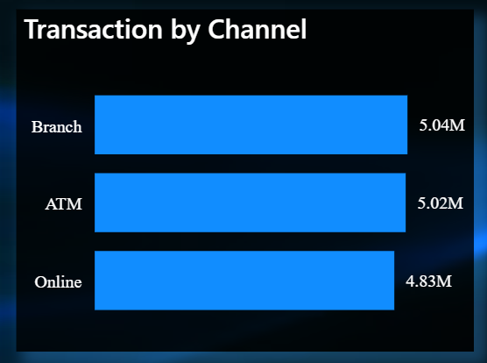
Shows transaction volume across ATM, Branch, and Online channels.
ANALYSIS
Branch has the highest transaction count.
ATM transactions are slightly lower than Branch .
Online transactions are lowest transaction count.
ACTIONS
Bar Chart
✔ Branch: Strengthen identity verification and monitor large cash transactions.
✔ ATM: Deploy anti-skimming technology and monitor repeated withdrawals.
✔ Online: Implement MFA, device/IP monitoring, and real-time fraud detection.
✔ Continuously review channel-wise fraud trends to improve security controls.
Transaction by Channel

Slide 12
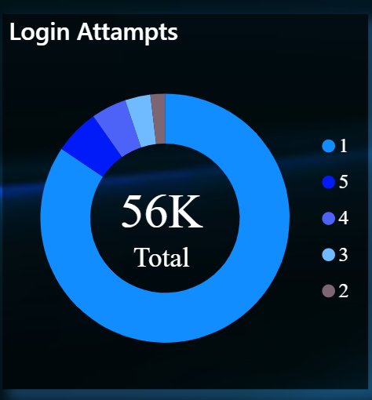
ANALYSIS
The donut chart displays the distribution of login attempts made before a transaction.
Total transactions analyzed: 56K.
Most transactions were completed with 1 login attempt, while only a small percentage required 2–5 login attempts.
Shows the number of login attempts
ACTIONS
✔ Monitor all single-attempt logins for unusual transaction behavior.
✔ Verify device ID, IP address, and location before high-value transactions.
✔ Apply risk-based authentication for suspicious activities.
✔ Send instant SMS/Email alerts for high-value transactions.
✔Automatically lock the account if a suspicious transaction is detected before transactions.
Donut Chart
Login Attempts Analysis

Slide 13
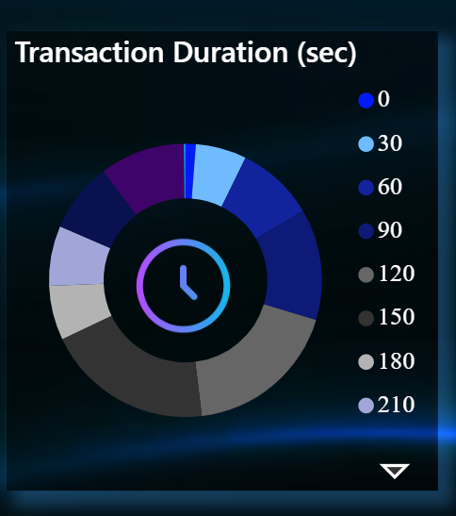
Analyze transaction duration to identify abnormal transaction processing times that may indicate fraudulent activities or suspicious behavior.
ANALYSIS
120–180 seconds represent the largest share of transactions, indicating that most transactions are completed within the normal processing time.
0–30 seconds have the lowest percentage. Extremely fast transactions may indicate automated scripts, bots, or unauthorized system activity.
180–300 seconds account for a significant number of transactions. Longer processing times may occur due to additional verification, network delays, or suspicious transaction reviews.
Transactions with 240–300 seconds should be monitored closely, especially when combined with unusual login attempts, high transaction amounts, or unfamiliar devices.
Donut Chart
ACTIONS
Transaction Duration
✔ Monitor unusually fast transactions (0–30 sec) to detect bots or automated fraud.
✔ Flag transactions exceeding 240 seconds for additional fraud screening.
✔ Continuously update fraud detection models using historical transaction duration patterns.

Slide 14
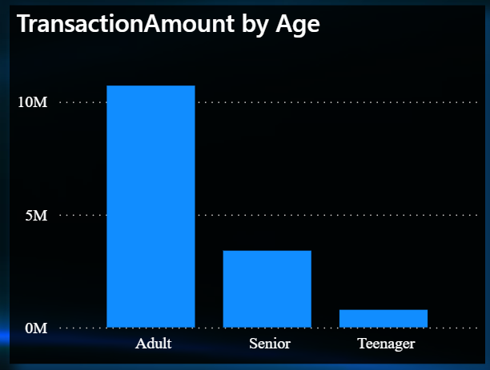
The chart shows the total fraud transaction amount across different age groups.
Age Groups:
Teenagers: 13–19 years
Adults: 20–60 years
Seniors: 60+ years
ANALYSIS
Adults contribute the highest transaction amount.
Seniors contribute a moderate amount.
Teenagers contribute the lowest amount.
ACTIONS
✔ Enable transaction limits, parental monitoring, and awareness on online payment safety.
✔ Implement AI-based fraud detection, multi-factor authentication (MFA), device fingerprinting, and real-time transaction monitoring.
✔ Introduce OTP verification for high-value transactions, fraud alerts, scam awareness campaigns, and dedicated customer support.
Column chart
Transaction by Age Group

Slide 15
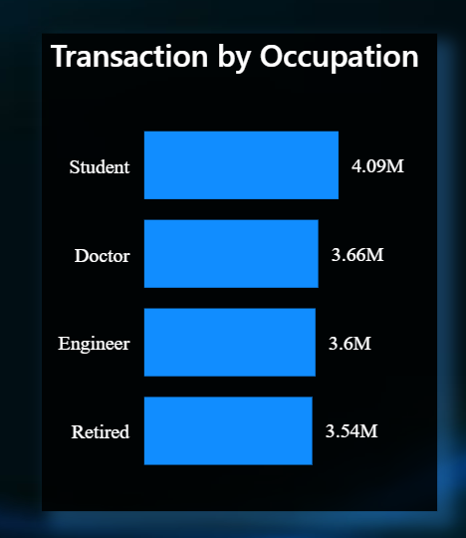
ANALYSIS
Shows transaction amounts across different occupations
Students recorded the highest fraud transaction amount (4.09M), indicating they are the most targeted or vulnerable customer segment.
Doctors and Engineers also experienced significant fraudulent transactions, suggesting that higher-income professionals are common fraud targets.
Retired customers show a slightly lower fraud amount but remain a high-risk segment due to potential vulnerability to scams.
The difference between occupations is relatively small, indicating that fraud affects multiple customer groups rather than a single occupation.
Bar Chart
ACTIONS
✔ Implement occupation-based risk scoring within the fraud detection system
✔ Provide targeted fraud awareness campaigns:
Students: Online payment and phishing awareness.
Doctors & Engineers: Secure banking and credential protection.
Retired Customers: Scam prevention and identity verification education.
Transaction by Occupation

Slide 16
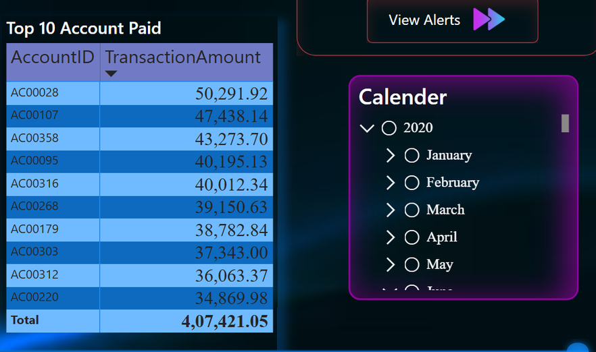

Top 10
transactions
by period
To identify the accounts with the highest transaction amounts and analyze fraud patterns over a selected time period using interactive date filters.
FINANCIAL MECHANICS
Account AC00028 holds the peak transaction value of $50,291.92.
Aggregate transactions for the top ten accounts stand at $407,421.05.
The Calendar slicer allows users to isolate specific Years , Months and Days to track transaction trends across the top 10 highest amounts.
ACTIONS
✔ Tracking the largest transaction allows to understand exactly how much money is at risk.
✔ Helps fraud analysts focus on accounts that may require further investigation.
✔ Enables time-based analysis using the Calendar slicer to detect unusual transaction patterns.
✔ Supports faster fraud detection and better risk management.
✔ Improves decision-making by highlighting high-value transactions that may indicate suspicious activity.
Understanding Bank Revenue

Slide 17

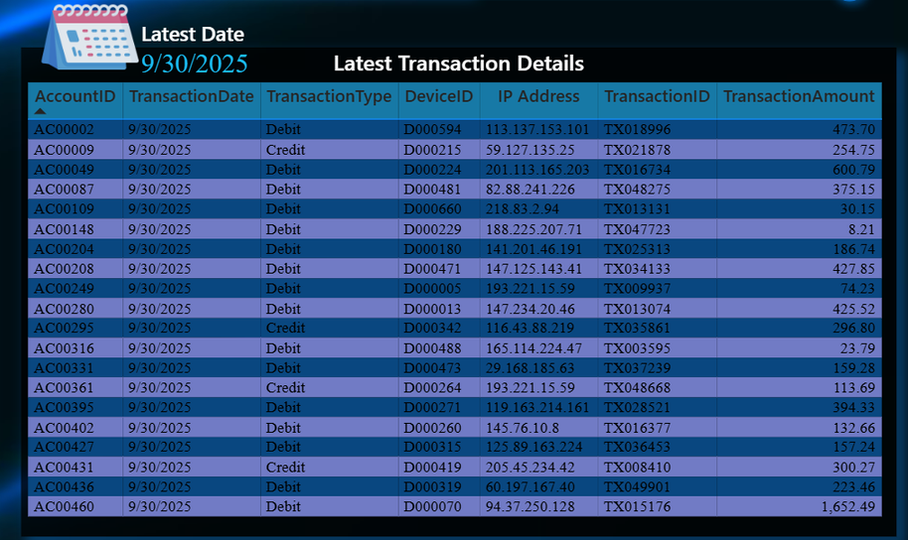
Latest Transaction Details
Latest Transaction Date: 30-09-2025
ACTIONS
INFORMATION INCLUDED
Most transaction amounts are relatively small (below ₹500–₹600).
One transaction of ₹1,652.49 stands out as the highest amount in the latest records.
Most recent transactions are Debit transactions.
Device IDs and IP addresses provide valuable information for identifying suspicious access patterns.
Account ID
Transaction Date
Transaction Type
Device ID
IP Address
Transaction ID
Transaction Amount
ACTIONS
✔ Monitor the latest banking activities.
✔ Tracing the preceding transaction based on the last recorded transaction will help establish a pattern.
✔ Identify suspicious or high-value transactions.
This table displays the most recent transaction records based on the selected filters.

Slide 18
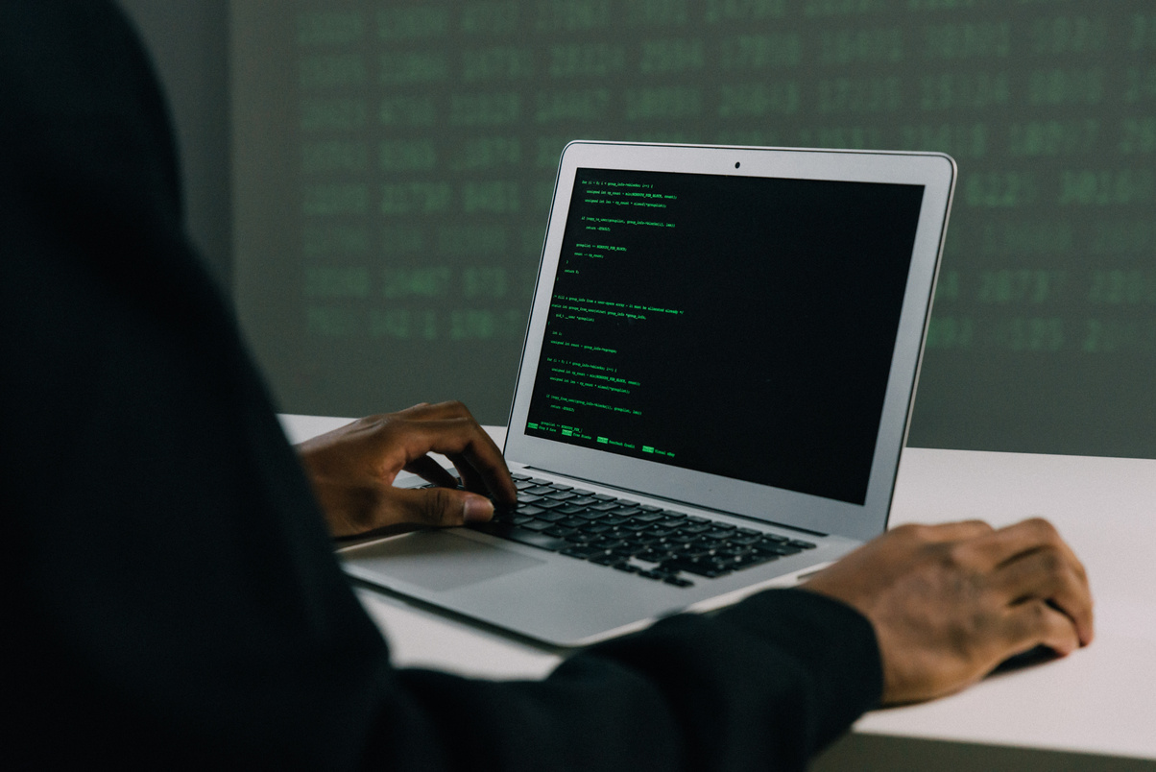

Business Objectives
Reduce financial losses caused by fraudulent transactions.
Improve fraud detection efficiency.
Monitor transaction trends and customer behavior.
Identify unusual transaction patterns.
Strengthen banking security and compliance.
Provide management with real-time KPIs and reports.
Expected Outcomes
Early identification of suspicious transactions.
Better fraud prevention strategies can be developed.
Improved customer trust and account security.
Faster investigation and response to fraud cases.
Clear visualization of fraud trends for business stakeholders.

Slide 19

Thank You
Appreciate Your Time and Attention
Thank you for taking the time to explore this presentation. Your attention and interest are highly valued.
PRESENTED BY:
Rittika Ghosh

